Slide 1
Analyzing Health Equity Using Household Survey Data
Lecture 7
Concentration Curves
Notes:
In this lecture we begin to introduce the analytical tools that will be used in the remainder of the course to assess and measure socioeconomic-related inequality in health variables. These tools are all rank-based measures of inequality. That is, they are based on ranking individuals or households by the measure of living standards and evaluating the cumulative distribution of the health variable across this ranking.
The advantage of these methods over rich-poor rate ratios or quintile means of health is that they take account of the full distribution and so are not dependent upon arbitrary dichotomisation or categorisation.

Slide 2
How to measure health disparities?
Measures of dispersion like the variance, coefficient of variation, or Theil’s entropy inform of total, not socioeconomic-related health inequality
Relative risk ratios, e.g. mortality in top to bottom occupation class, do not take account of group sizes
Rate ratios of top to bottom quintiles do not reflect the complete distribution
Borrow rank-dependent measures—Lorenz curve and Gini Index—and their bivariate extensions—concentration curve and index—from income distribution literature and apply to socioeconomic-related inequality in health variables

Slide 3
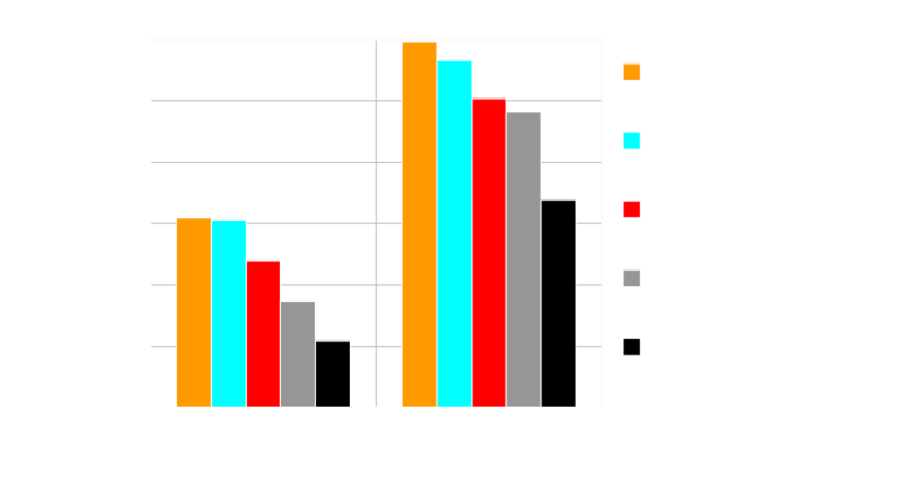
In which country are child deaths distributed most unequally?
Comparison made difficult by differences in levels.
And have to rely on top versus bottom relativities.
Notes:
If look carefully, can see that rate for poorest quintile in India is three times that of top quintile. In Mali, the ratio is 2.
But cannot easily take account of the rates between the extremes.

Slide 4
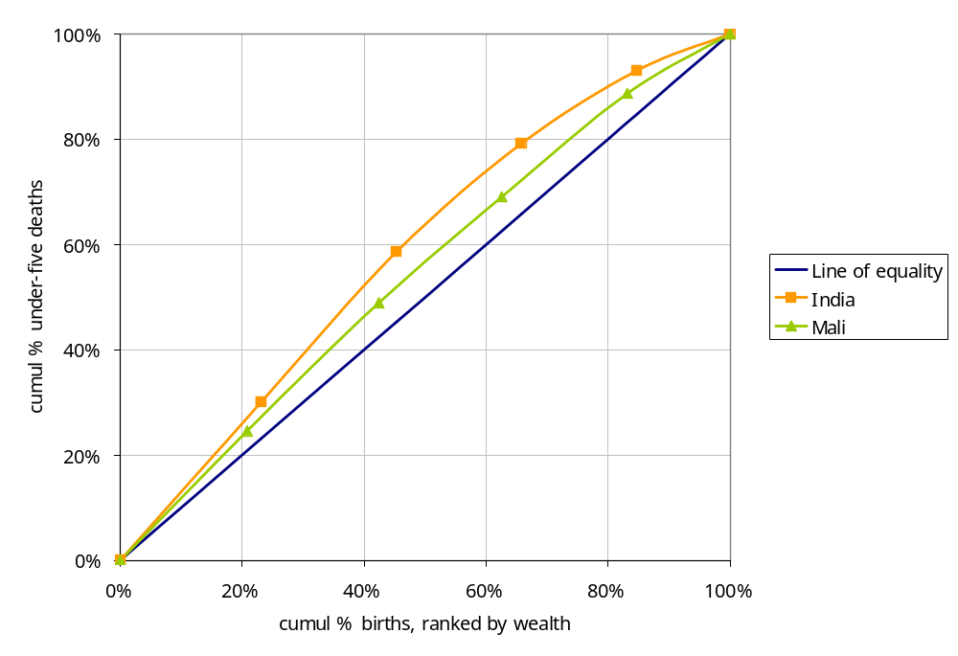
Comparison is easier using cumulative distributions - Concentration curves
Child deaths are
disproportionately
concentrated on the poor
in both countries
But the disproportionate
concentration (inequality)
appears greater in India
Notes:
Births are ranked by household wealth on the horizontal, from poorest to richest left to right.
On the vertical axis is plotted the cumulative proportion of all under-five deaths.
If deaths were unrelated to wealth in both countries, the curves would lie on the diagonal. The further the curve lies above the diagonal, the greater the concentration of deaths among the poor.

Slide 5
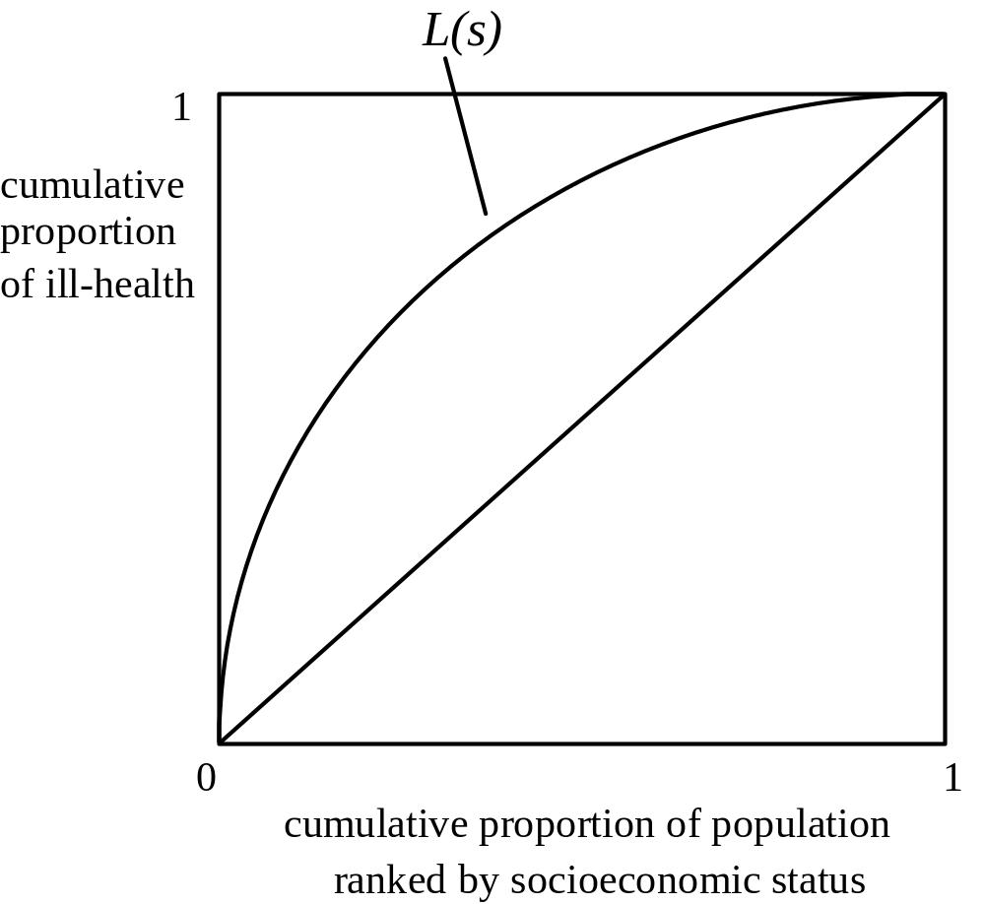
In general, concentration curve plots the cumulative % of health variable against the cumulative % of population ranked by socioeconomic status
Must be possible to sum
health variable.
Living standards variable only
needs to provide a ranking.
Curve above the diagonal →
concentration among the poor
Curve below the diagonal →
concentration among the rich
Curve on the diagonal = equality

Slide 6
Graphing concentration curves from grouped data
Rank indvs/HHs by living standards variable, into quintiles (or deciles)
Obtain for each quintile the mean of variable of interest and # relevant cases
Paste quintile means and counts into Excel; form cumulative % relevant cases and corresponding cumulative % of total value of variable of interest; graph concentration curve using xy chart

Slide 7
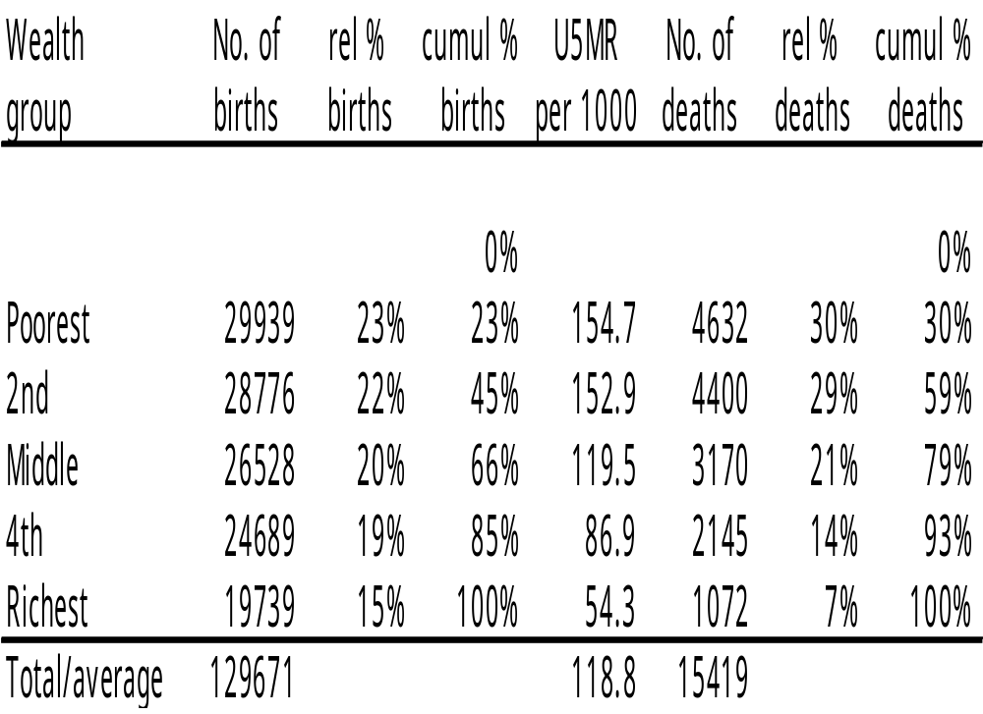
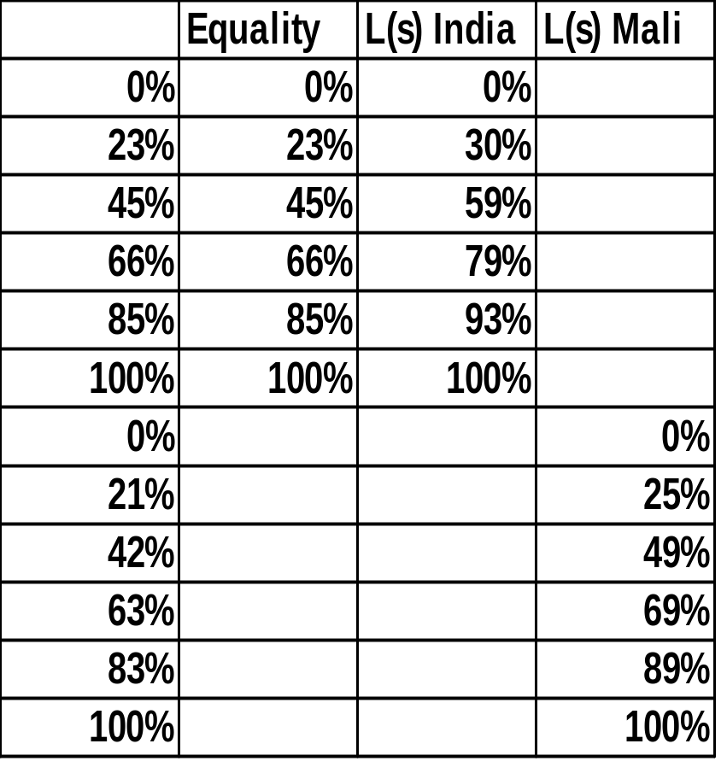
Under-five deaths in India
In excel

Slide 8
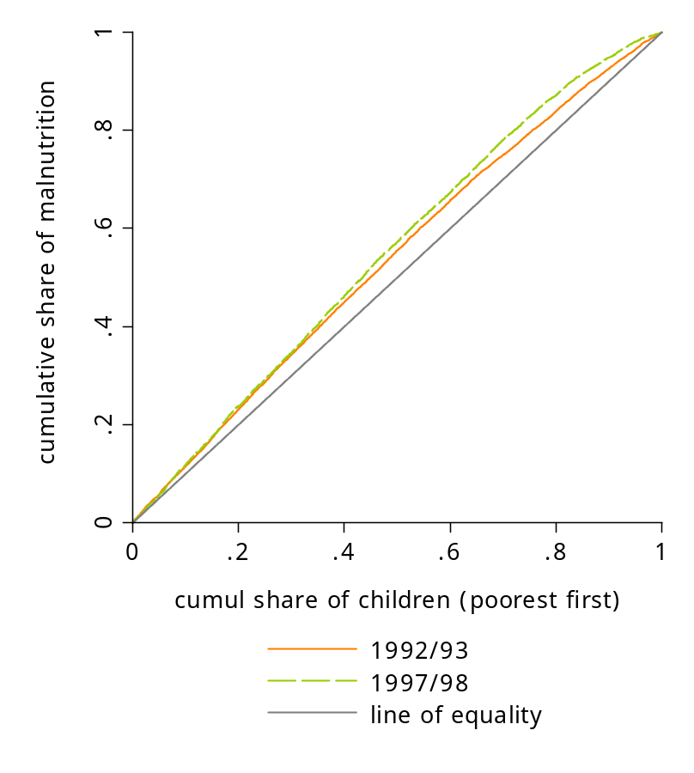
But the advantage of the concentration is that it can be computed from individual level data and so gives a picture of the complete distribution
Concentration Curve for Child Malnutrition in Vietnam
glcurve neghaz, glvar(yord) pvar(rank)
sortvar(lnpcexp) replace by(year)
split lorenz
or use twoway graph routines to plot the
co-ordinates yord & rank
Notes:
If individual level data are available, it would be silly to graph a concentration curve from the quintile or decile cumulative frequencies. One would be throwing information away and producing only an approximation to the concentration curve. Better to compute the cumulative frequencies from the individual level data, with individuals ranked by the living standards variable.
The example shows the concentration curve for the negative of the height-for-age z-score (haz) in Vietnam in 1993 and 1998 from the respective Vietnam Living Standards Surveys. The more negative is haz, the less well nourished is the child. Since we take the negative haz, a higher number indicates greater malnutrition. Children are ranked from left to right by household consumption per capita.
Both curves lie above the diagonal indicating that malnutrition is concentrated on the poor in both years.
For the first two-fifths of the income distribution, there is little or no difference between the concentration curves, indicating that the degree of concentration of malnutrition on the poorest children did not change over time. But further up the distribution, the 1998 curve lies outside that of the 1993 curve suggesting that child malnutrition was more unequally distributed in the later year.
In Stata, concentration curves can be drawn using the ado glcurve. glvar() gives a name to the y-ordinate of the graph and pvar() to the x-ordinate. These are saved and can be used later. The x-ordinate is the individual’s fractional rank in the living standards distribution. sortvar() declares the variable on which individuals are to be ranked. replace instructs Stata to write over the pvar() variable that will already exist if the command had been run previously. by() requests separate curves split by the dichotomous variable (year). lorenz requests that the y-ordinates of the curve are scaled by the mean of the variable, such that cumulative shares are plotted. If this is left out then a generalised concentration (Lorenz) curve is plotted, i.e cumulative means on the y-axis.
For more control of the appearance of the graph, the y- and x-ordinates can be passed to twoway.

Slide 9
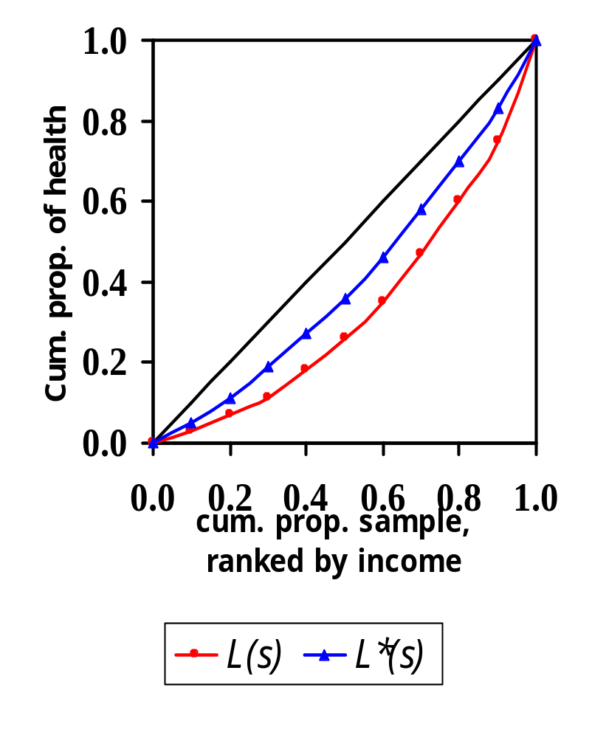
Assessing inequality in the standardized distribution of health
Concentration curve L(s) lies below diagonal → health is concentrated among the rich;
L*(s) is the indirectly standardized concentration curve, i.e. the (unavoidable) inequality to be expected on the basis of the age-sex distribution
Inequality favoring the rich if L(s) lies below L*(s)
Notes:
7
1. Note here that health and not ill-health is on the y-axis. Hence, with inequality favouring the rich, lower income percentiles have less than their population share of health and the curve lies below the diagonal.

Slide 10
Concentration curve (Lorenz) dominance tests
Concentration curve A dominates the 45º line /Lorenz curve/conc. curve B if it lies above the other line/curve
Comparing the point estimates of curves is not sufficient to establish dominance
Concentration curves are estimated from survey data and so display sampling variability
Need to conduct formal tests of significance of difference between curves
Notes:
1. Note that dominance is not equivalent to “more unequal”. If both curves lies above the 45o line, then A dominates B does mean that distribution A is more unequal than distribution B. But if both lie below the 45o line, the A dominates B means that distribution A is less unequal than distribution B.

Slide 11
Testing dominance b/w dependent curves
Test significance of difference between ordinates of curves at a number of quantiles
If the curves are independent, just requires the standard errors for the point estimates of the ordinates of each curve
But often the curves are dependent e.g. conc. & Lorenz curves, 2 conc. curves estimated from same sample
Requires standard errors for the difference between ordinates allowing for dependence
See Bishop, Chow & Formby (IER, 1994) & Davidson & Duclos (Econometrica, 1997)
Notes:
Curves are dependent if they are derived from the same variables. For example, a concentration and a Lorenz curve are both plotted against income rank. Or if they are computed from the same data and both distributions may be influenced by the same unobservables.
A quantile is a percentile point in the distribution of the ranking variable – 1st percentile, 5th percentile, etc.

Slide 12
Decision rule
What constitutes a significant difference b/w two curves?
At least one significant difference in one direction and no significant difference in the other?
This will over reject the null (for given significance level) since are making multiple comparisons
Can use same decision rule but correct critical values (using Studentised Maximum Modulus)
Or require significant difference at all quantiles compared – (Intersection Union Principle)
Dardanoni & Forcina (Econometrics J. 1999) show IUP is less likely to falsely reject null but has much lower power to find dominance when exists
Notes:
If we use a critical value for 5% significance level to test significance between co-ordinates, then as the number of points of comparison is increased, the more likely it becomes that the null hypothesis will be falsely rejected. Hence, it is necessary to correct the critical value for the number of comparisons made. This is the first approach described above. The SSM distribution takes account of the number of points of comparison.
Alternative is to employ a more strict decision rule, requiring a significant difference at all points of comparison in order to reject the null.
Dardanoni and Forcina reach their conclusions from Monte Carlo analysis.

Slide 13
Tests can also find
Non-dominance if no significant difference at any quantile (with MCA rule)
Curves cross if at least one significant difference in each direction

Slide 14
Number of comparison points
If too few, not testing dominance across full range of distribution
But always difficult to find significant differences at extremes of curves
Common choice is to test at 19 evenly spaced quantiles from 5% to 95%
Notes:
1. At the extremes of the distribution, the y-ordinate must always approach 0 (at low end) and 1 (at high end). So, difficult to find significant differences between curves in these regions.

Slide 15
Stata ado for dominance testing
dominance varlist [if] [in] [weight]
[using filename], sortvar() [options]
Dominance of CC against 45o line and Lorenz:
dominance totsub [aw=wght], sortvar(hhexp_eq)
Dominance of one CC against another:
dominance nonhsub ipsub [aw=wght], sortvar(hhexp_eq)
Dominance of independent CC:
use India
dominance totsub [aw=weight] using Vietnam,
sortvar(hhexp_eq) labels(India Vietnam)
Notes:
This ado is available from the AHE book website.
If one variable is included in varlist, dominance of the concentration curve for this variable is tested against both the 45-degree line and the Lorenz curve of the living standards variable specified in sortvar(), which must be included. The default uses the multiple comparison approach decision rule, with comparisons at 19 equally spaced quantile points and a 5 percent significance level. The decision criterion can be changed to that of the intersection union principle with the option rule(iup), or results using both decision rules can be requested with rule(both). The number of comparison points can be changed with the option level(#), with 20 being the maximum value. The significance level can be changed from 5 percent to 1 percent with level(1).
Quintile (or decile) cumulative shares of the health variable and the living standards variable can be requested by the option shares(quintiles). This will also report the p-value for a test of significant differences between the cumulative shares of the health and living standards variables at each quintile (decile). Differences between the shares of each variable and the population shares are also tested.
The first example tests dominance of the concentration curve for the subsidy to public health care in India against the 45 degree line and the Lorenz curve for household expenditure per equivalent adult. See chapter in AHE.
The second example tests dominance of the subsidy to non-hospital care against that for inpatient care. See graph on next slide.
The third example tests dominance of the concentration curve for the total public health care subsidy in India against that in Vietnam. In this case the curves are assumed independent. The respective datasets are names India and Vietnam.
See lecture 12 for more on these examples.

Slide 16
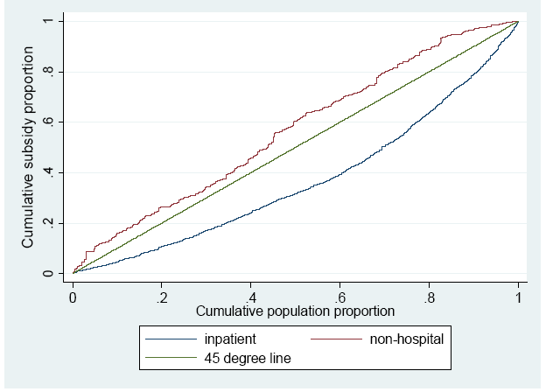
Concentration curves for subsidies to inpatient and non-hospital care in India
Notes:
Source O’Donnell, van Doorslaer et al, 2007).
The test reveals that the curve for the non-hospital subsidy dominates (is more pro-poor) than that to inpatient care.

